Slide 1
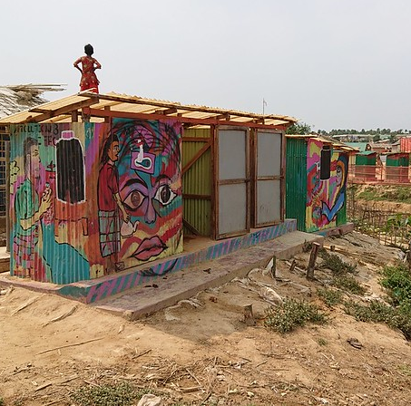
Sandec
Water and Sanitation in Developing Countries
Innovations in Sanitation Planning
Dr Abishek Narayan
abishek.narayan@eawag.ch
Eawag: Swiss Federal Institute of Aquatic Science and Technology

Slide 2
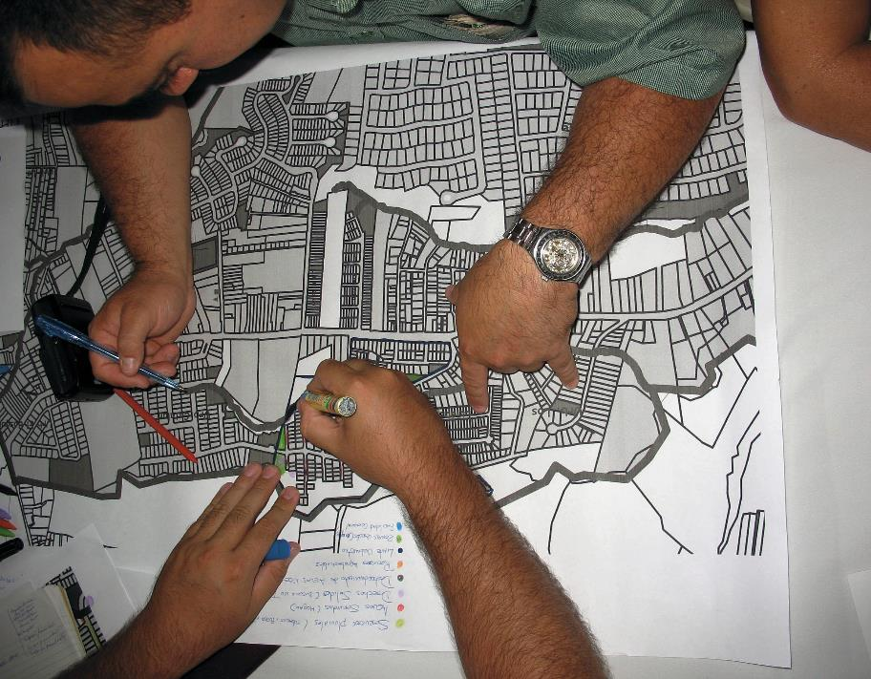
Learning Goals
Understand the CWIS approach
Examples of latest research in planning
Explore the landscape of WASH Careers
Game on Political Economy of WASH
Case study and group work questions and clarifications
Choose between 3 or 4
© Sandec

Slide 3

Potential for integrated planning models?
Overriding principal | Bureaucratic organization | Market processes | Community action
Decision-makers | Administrators, engineers, public officials | Individuals, households, vendors, enterprises | Leaders and members of grass-roots organizations
Criteria for decisions | Policy, and conformity with a plan | Efficiency, maximization of profit or utility | Interests of members and visions of leaders
Guides for behaviour | Targets, regulations and technical standards | Price signals, sanitation marketing | Agreements and accepted goals
Sanctions | State authority backed by coercion | Financial loss | Social pressure
Mode of operation | Top-down | Individualistic | Bottom-up
1
Planning model
2
Market model
3
Collective action model

Slide 4

Urban WASH – complexities & pressures
Urbanization issues: migration, slums, population density, inequities, tenure insecurity etc.,
Multi-sectoral interactions: water, solid waste, storm water, public health, urban planning, environment etc.,
Multi-dimensional aspects: social, cultural, engineering, economic, institutional etc.,
Notes:
The reason for such poor access is that – Urban sanitation in the context of the Global South is not a piece of cake.
There are various complexities and pressures that urban sanitation has to simultaneously deal with.
There are urbanization issues: for example….
There are multi-sectoral interactions: ….
Then, providing urban sanitation needs to account for several dimensions that go beyond just infrastructure.

Slide 5
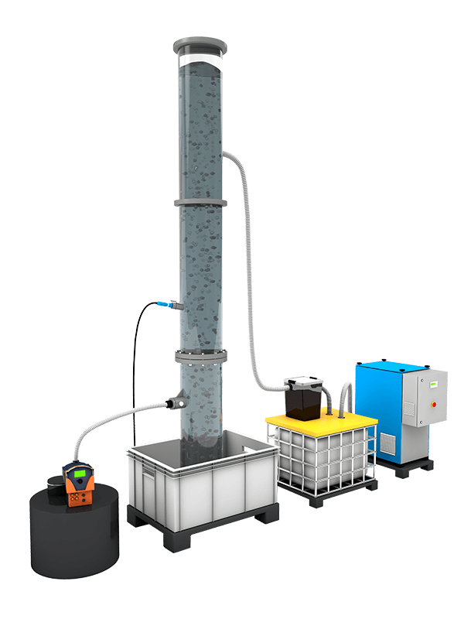
Advancements in urban WASH
Aurin Resource Recovery from Vuna ©
Infrastructure focus only to service focus
Public health only to Environmental health
Sewered only to Non-sewered & decentralized
Pollution management only to Resource recovery
Public service only to involvement of private sector
Top-down planning only to Collective action and market model
Notes:
Since the turn of the century, there are also many advancements that have happened in the field of urban sanitation.
Right from more explicit targets in the SDGs based on the sanitation ladder, to a higher acceptance of non-sewered sanitation solutions.
There have also been increased involvement of the private sector in the santiation economy, because of the new opportunities and technologies that enable resource recovery.
Finally, on the planning front, there have been several participatory approaches, and several tools that have been developed to assist the planning process.

Slide 6
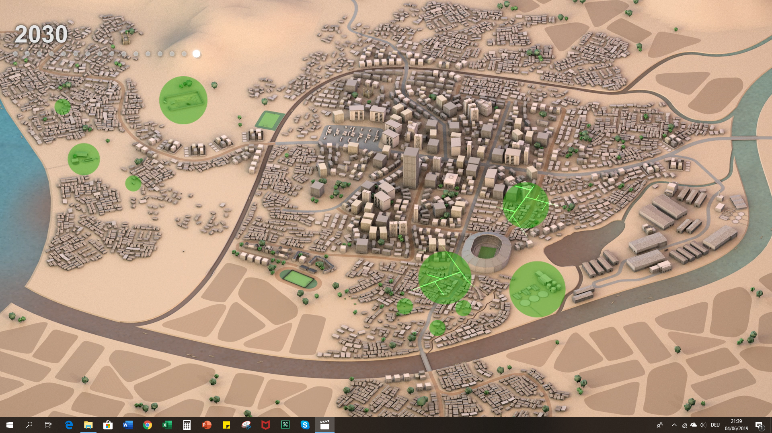
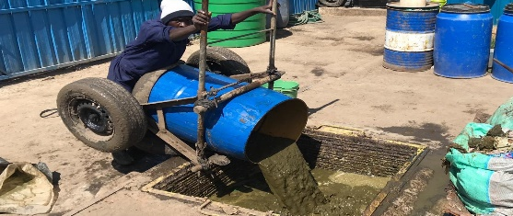
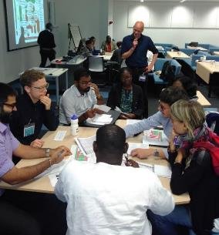
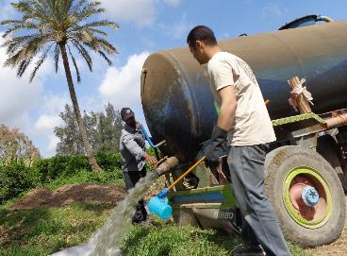
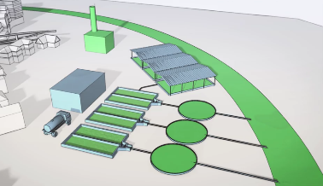
Equity in service
Sanitation Status : Urban > Rural
Inclusive Planning
Environmental and social justice
Conxtextual solutions
CWIS brings various evolved thinking of urban sanitation under one umbrella

Slide 7
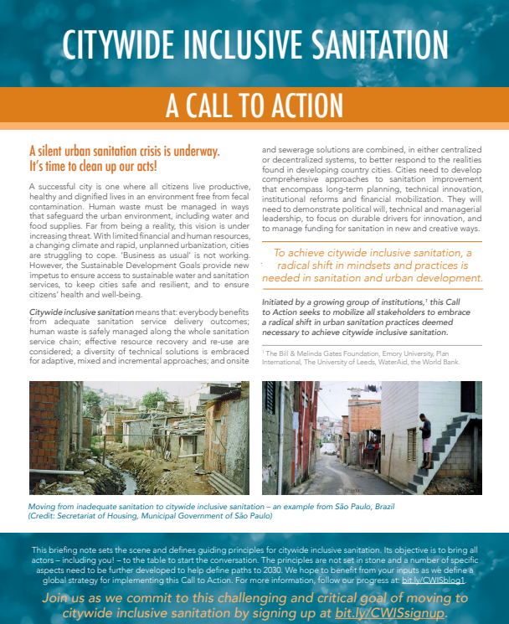
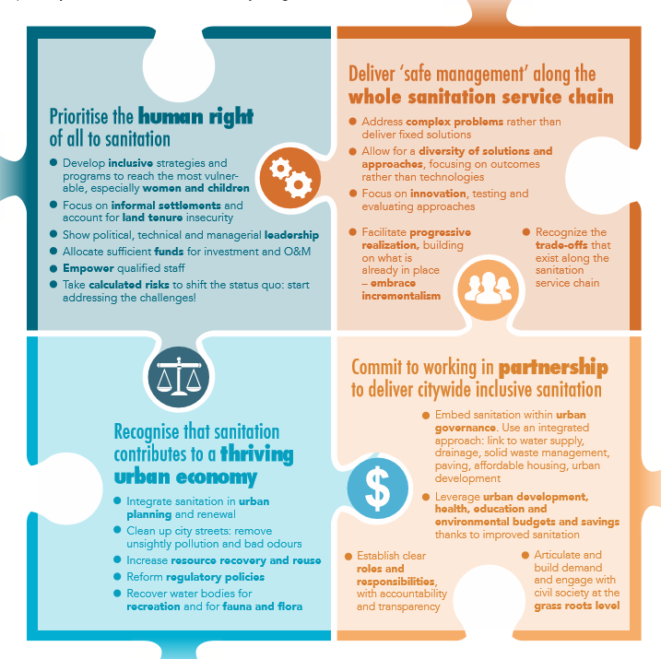









Emergence of CWIS
Brings various evolved thinking under one holistic approach.
Prioritize the Human rights approach
Deliver safe management of whole service chain
Recognize sanitation’s role in urban economy
Work in partnerships
A consensus between research institutions, development banks, NGOs governments etc.
CWIS emerged as a paradigm shift since 2016 and has gained huge traction since.
(BMGF et al., 2017)
7
Notes:
So building on all this momentum was CWIS.
What’s special about it is the backing it received since its inception – to rethink sanitation and bring all the evolved thinking and lessons learnt into a holistic approach.
Many including the ADB has now adopted the CWIS thinking.

Slide 8
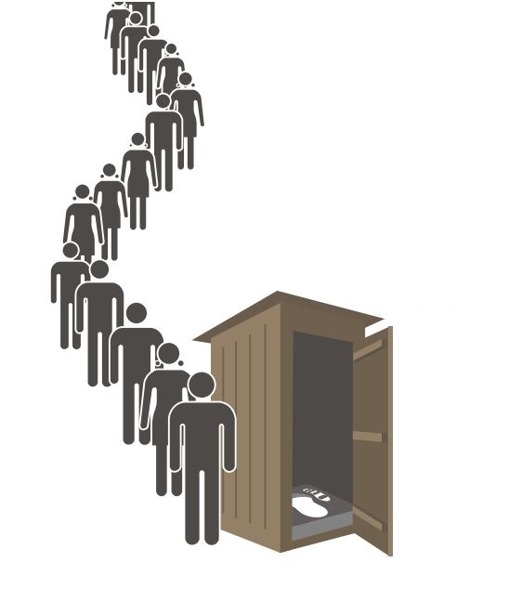

What is CWIS?
An approach to urban sanitation, where all members of the city have equitable access to adequate and affordable improved sanitation services through appropriate systems of all scales (sewered & non-sewered), without any contamination to the environment along the entire sanitation value chain.
(Narayan and Lüthi 2020)
Notes:
Based on several expert interviews, workshops and discussions on SuSanA meetings, this definion was arrtived at.

Slide 9
Manila Principles on CWIS
1. Equity Everyone in an urban area — including communities marginalized by gender, social, and economic reasons — benefit from equitable, affordable, and safe sanitation services.
2. Environment and public health Human waste is safely managed along the entire sanitation service chain, starting from containment to reuse and disposal.
3. Mix of technologies A variety of sewered and non-sewered sanitation solutions coexist in the same city, depending on contextual appropriateness and resource recovery potential.
4. Comprehensive planning Planning is inclusive and holistic with participation from all stakeholders including users and political actors — with short- and long-term vision and incremental perspective and is synergistic with other urban development goals.
5. Monitoring and accountability Authorities operate with a clear, inclusive mandate, performance targets, monitoring requirements, human and financial resources, and accountability.
6. Mix of business models Sanitation services are deployed through a range of business models, funding sources, and financial mechanisms to reach all members equitably.
(Narayan and Lüthi 2020)
Notes:
CWIS is best explained through the Manila Principles.

Slide 10





CWIS has wide uptake
Implementation of CWIS projects mainstreamed
Way forward in International development
Degree programs and Cap Dev initiatives
$6+ Billion
Invested in CWIS project by various Banks and Dev agencies
Wide research on CWIS topics
Tools to plan and design CWIS
Notes:
Over 6 billion dollars invested,
Degree programs on CWIS
Various tools being developed
Seen as a the way forward

Slide 11
Planning for Equity

Slide 12
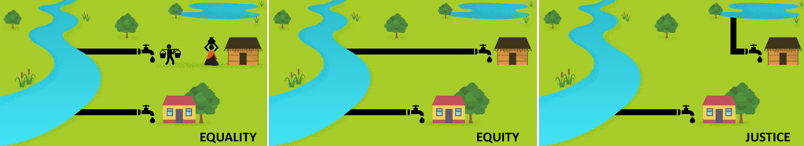
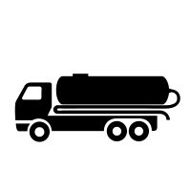


Equality, Equity and Justice in WASH
(Narayan and Agarwal, 2021)

Slide 13
Planning for Environmental Health

Slide 14
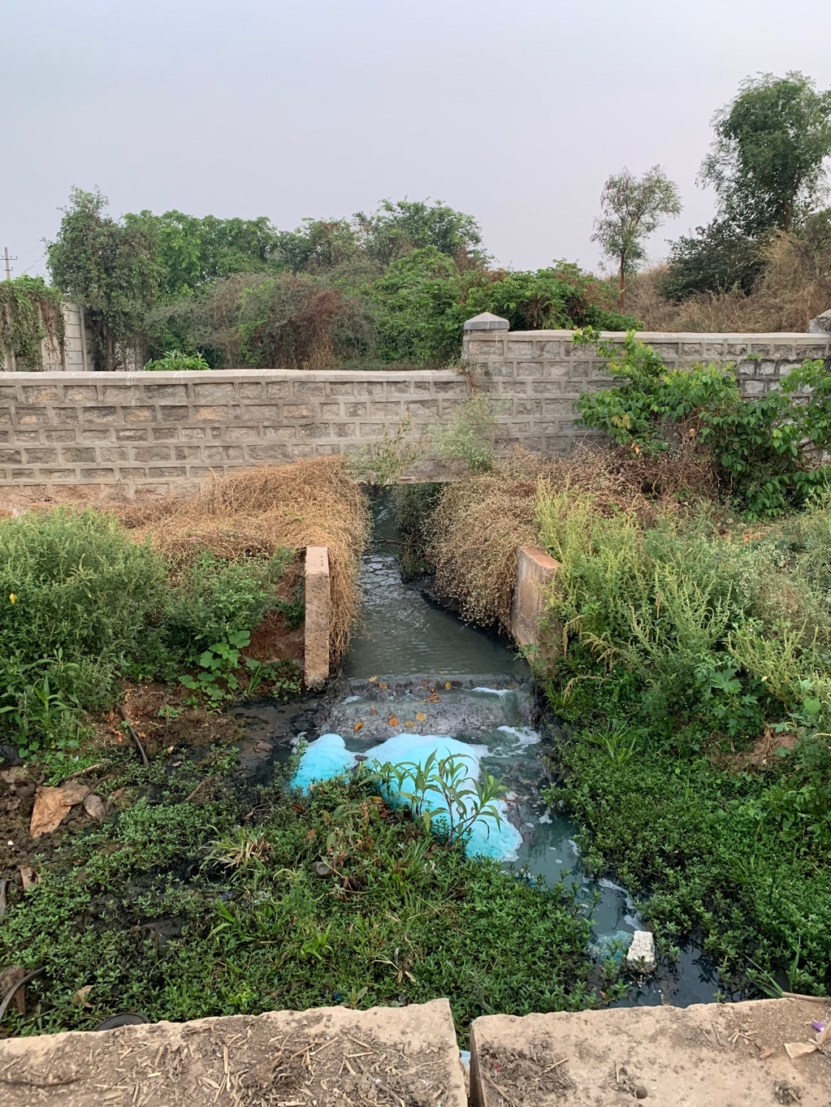
Environmental Health
80% of all wastewater is left untreated globally (UN Water 2018)
Poor sanitation pollutes the urban water bodies.
Godwin, Narayan & Scholten 2021

Slide 15
Planning Technology scales

Slide 16
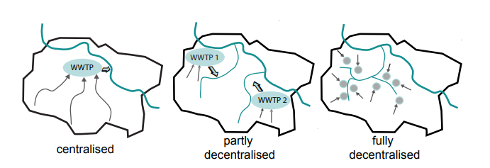
What does decentralization mean ?

Slide 17
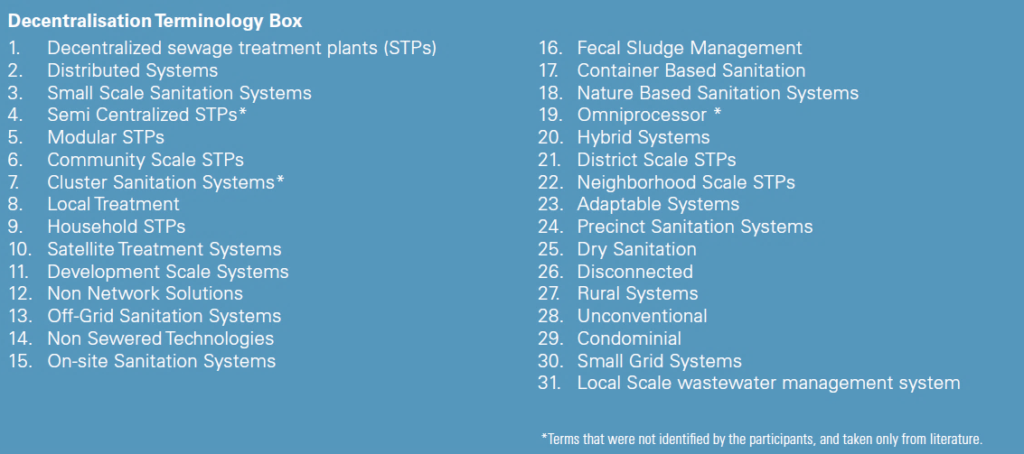
Terminologies on Decentralization
Narayan et al., 2020

Slide 18
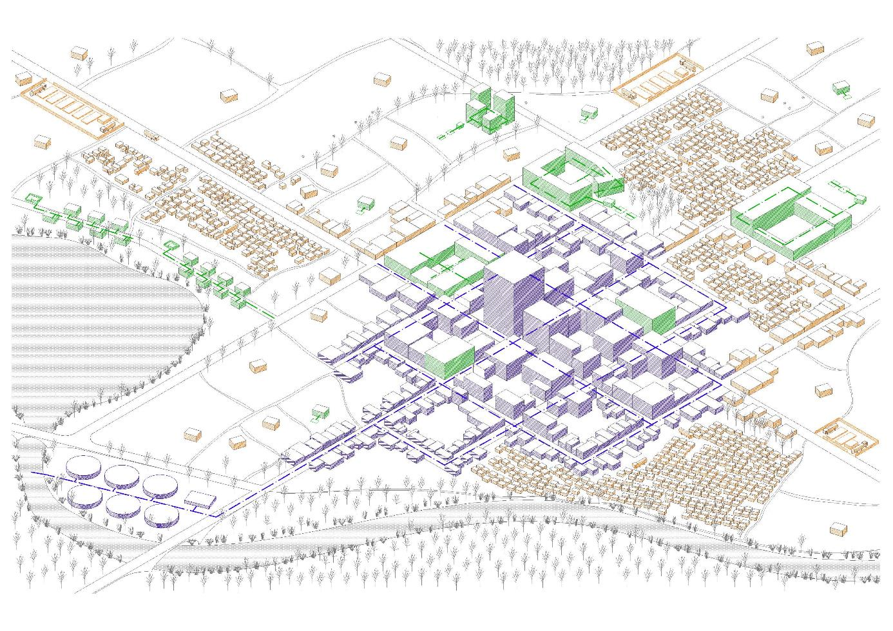
Context Specific technologies
Centralised systems where economy of scale works
Decentralised systems in areas dictated by topography, population density, and fund availability
Faecal Sludge Management in areas where access is an issue. e.g. slums or peri- urban settlements

Slide 19
Planning Framework

Slide 20
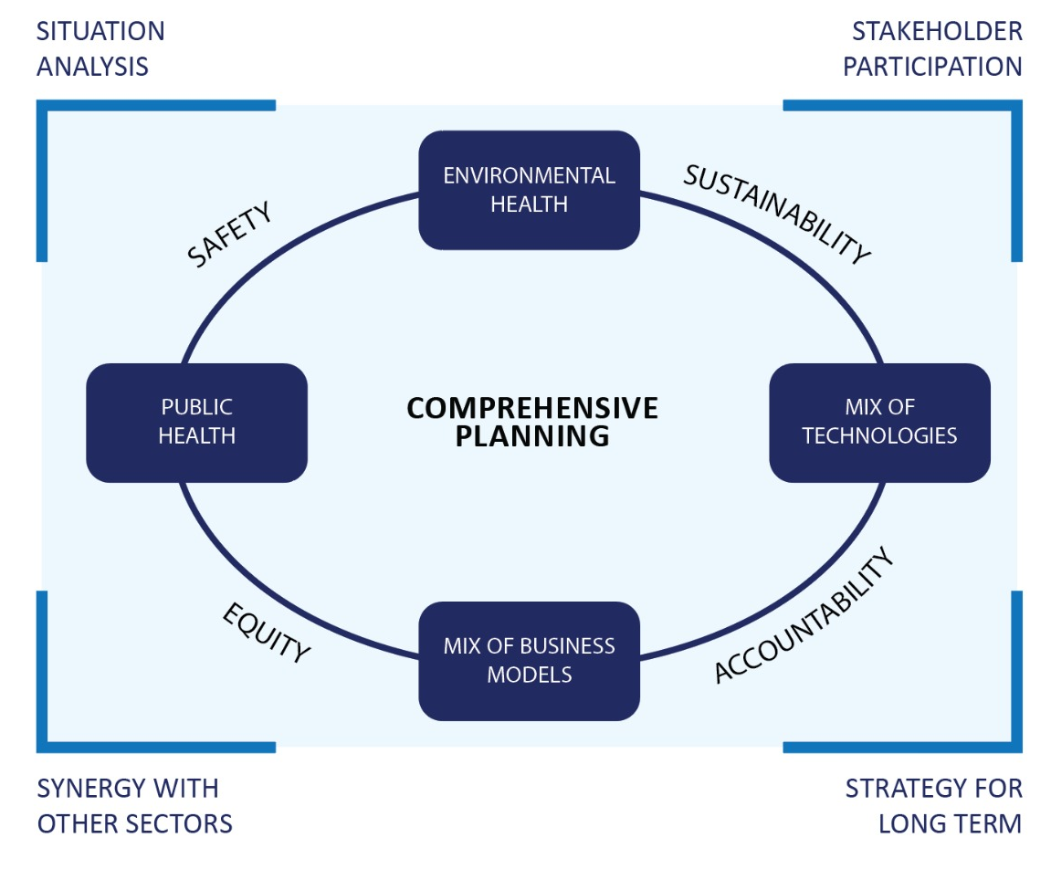
CWIS Planning Framework
(Narayan et al., 2021)
Notes:
Out latest thinking around sanitation.

Slide 21
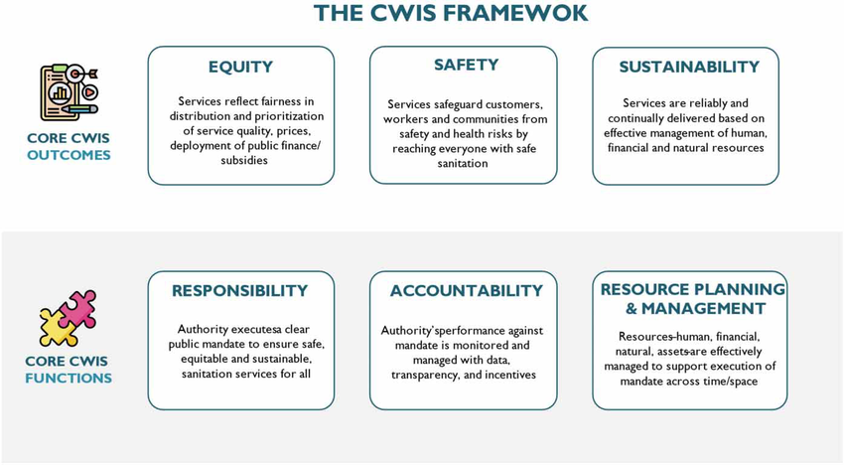
CWIS Service Framework
(Schrecongost et al., 2020)
Notes:
There are other prominent frameworks as well.

Slide 22
Synergistic Service Planning

Slide 23
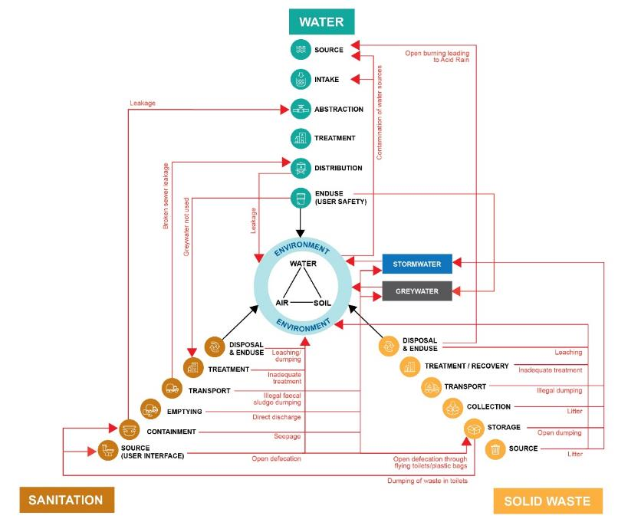
Negative interactions
Water, Sanitation and Solid Waste are inherently linked.
Often because of poor management, there are negative interactions between these sectors.
E.g: Solid waste clogging sewers or untreated wastewater contaminating water sources.
Narayan et al., 2021

Slide 24
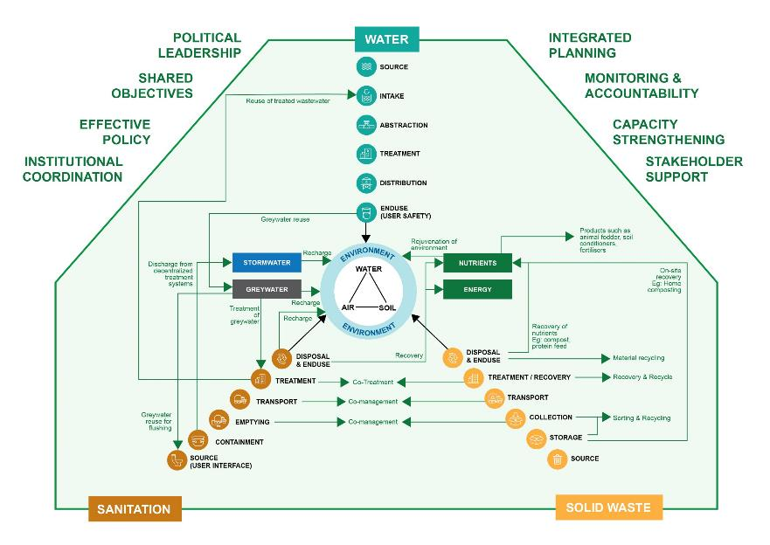
Enabling Environment is key!
Positive interactions
Can tap into synergies and co-benefits.
E.g: Reuse of treated water for flushing. Co-digestion of organic and faecal waste
Needs strong leadership and an enabling environment.
Narayan et al., 2021

Slide 25
Planning and Governance

Slide 26
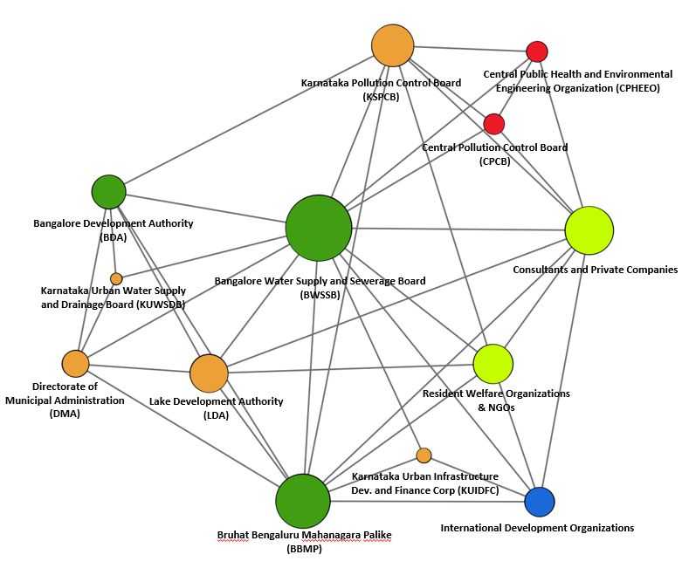
Coordination between agencies is a challenge
(Narayan et al., 2019) “Social Network Analysis for WASH” in Frontiers in Env. Sci

Slide 27
Planning & Financing

Slide 28
Mix of Services cheaper
Dutta, 2021; Daudley 2018

Slide 29
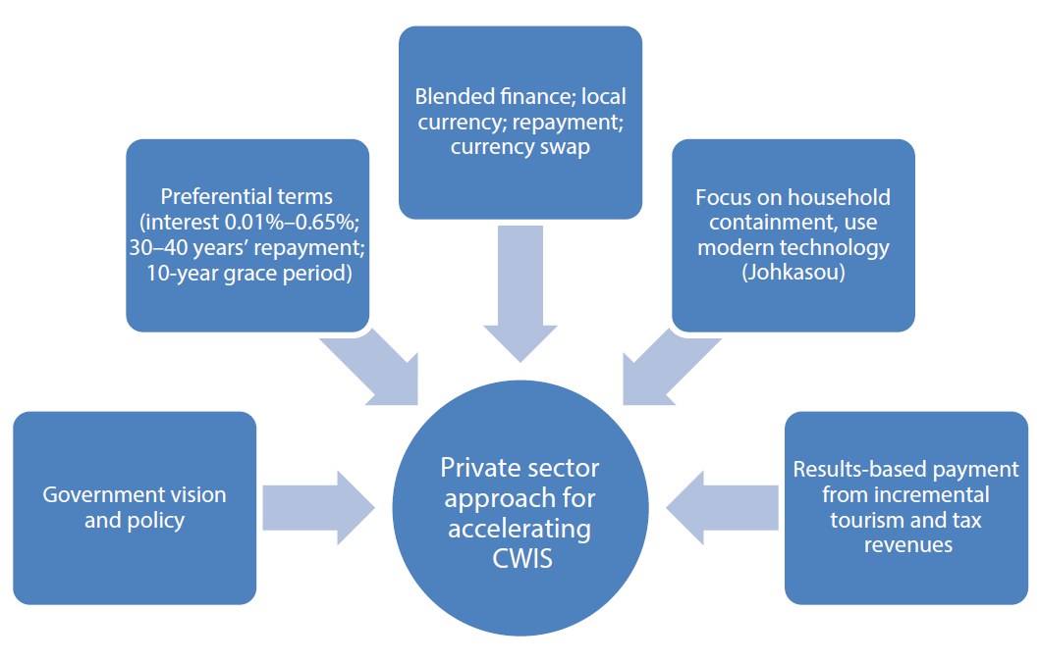
Investments in long-term financing
CWIS can benefit from long-term financing for it’s CapEx, and accrue benefits and returns in the long-term.
Long term financing options include Public Financing, PPPs, Blended Financing, Concessionary Loans, Impact investing etc.
No suitable examples exist in the sector. Needs novel institutional mechanisms
Wibowo et al., 2023
Notes:
Sanitation outcomes are long term: be it health, productivity gains or even tourism boosts.
So financing could be long term as well.

Slide 30
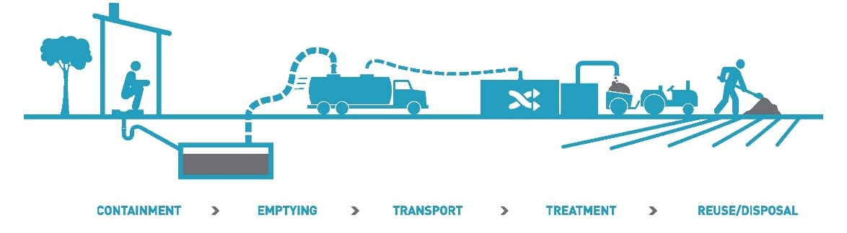




Challenges
Public Good vs Private Good
Incentive structures for private sector participation
Governance of diverse sanitation solutions
Standardization for onsite systems
Planning for CWIS is complex

Slide 31

(Optional) Game – Politics of WASH service provision

Slide 32






Making a Career in WASH
International Agencies
NGOs
Academia and Research
National & local Government
Consulting
Private Sector

Slide 33

SWP Youth
Network
Mentoring
Seed Funding
Global Youth Representation
www.swisswaterpartnership.ch/youth

Slide 34
Questions Regarding Case Study?
Questions Regarding other material?
Preparing for the Exam.

